Slide 1





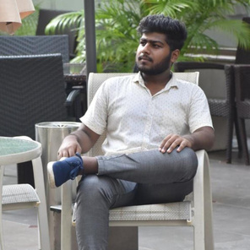

Dreadnought Robotics
Building, for a better future
Team
Anthrobot
Gyanesh Samanta
Souvik Dey
N Aditya Sai
Aman Sharma
SRM University of science and technology

Slide 2

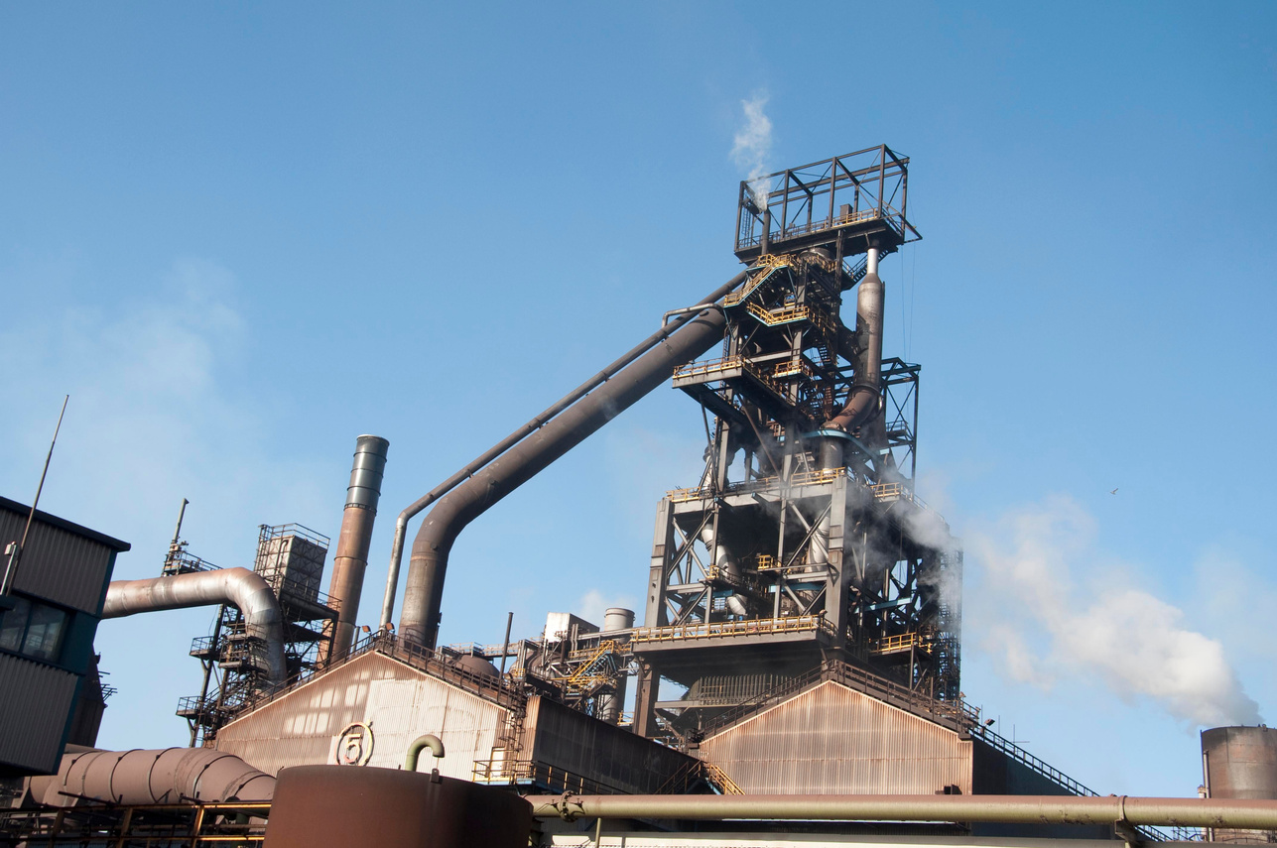
Introduction
Ground robots-Application Oriented Robots / Sensory robots
According to US Department of labour, 300 people are injured every year while working in a blast furnace.
The goal of our product is to tackle a life hazardous situation.
We aim to achieve this by our robot, aptly named "Anthrobot" that does the vital tasks that a human had to do in a blast furnace.
Namely:
To monitor vital stats on displays near the blast furnace
To check for purity and usage of components in the blast furnace.
The problem arises when people have to close the blast furnace, as the boiling metal squirts and spills at times, burning peoples skin off and at times, taking their lives.

Slide 3

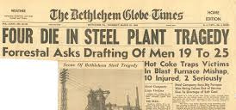
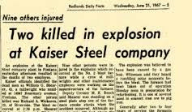
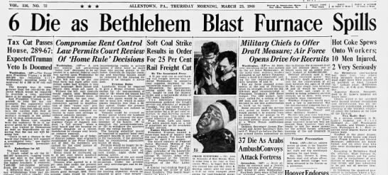
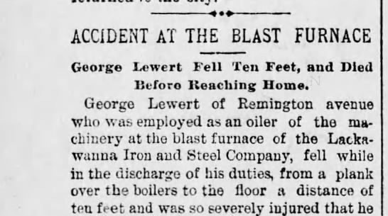
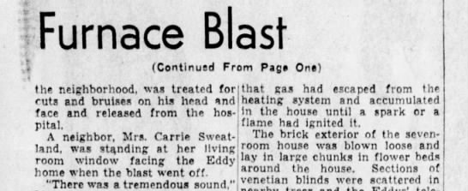
Newspaper clippings
Urgency!
These clippings showcase the damage this problem causes every year.

Slide 4
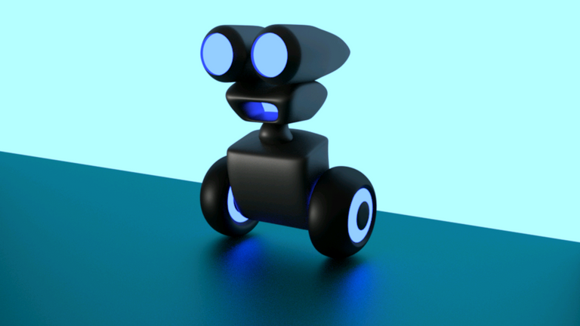









Let's go back to the previous pages and identify actions we can enhance or new steps we should start doing so we can help people at blast furnaces.
Action Items
1
2
3
4
list all the tasks that humans have to perform at a blast furnace
Shortlist the tasks that one robot can accomplish
test the functioning of the robot and improve components
Keep developing our robot for the future!.
Add your thought here
Add your thought here
Add your thought here
yes!
this is great
Add your thought here
Add your thought here
Add your thought here

Slide 5
Components required and approximate cost factor:
Component - Cost
Raspberry Pi -1500
Storage - 2 gb SD card
Camera module-800
Temp sensor- (up-to) 1273.15 Kelvin
Tin for body
Steel for structure
Motors- depends on weight of bot
Omni wheels- depends on weight of bot
6000-8000 Rs.

Slide 6
Thank you!
Thank you for participating. Hope to see you again at Round 3!

